Slide 1
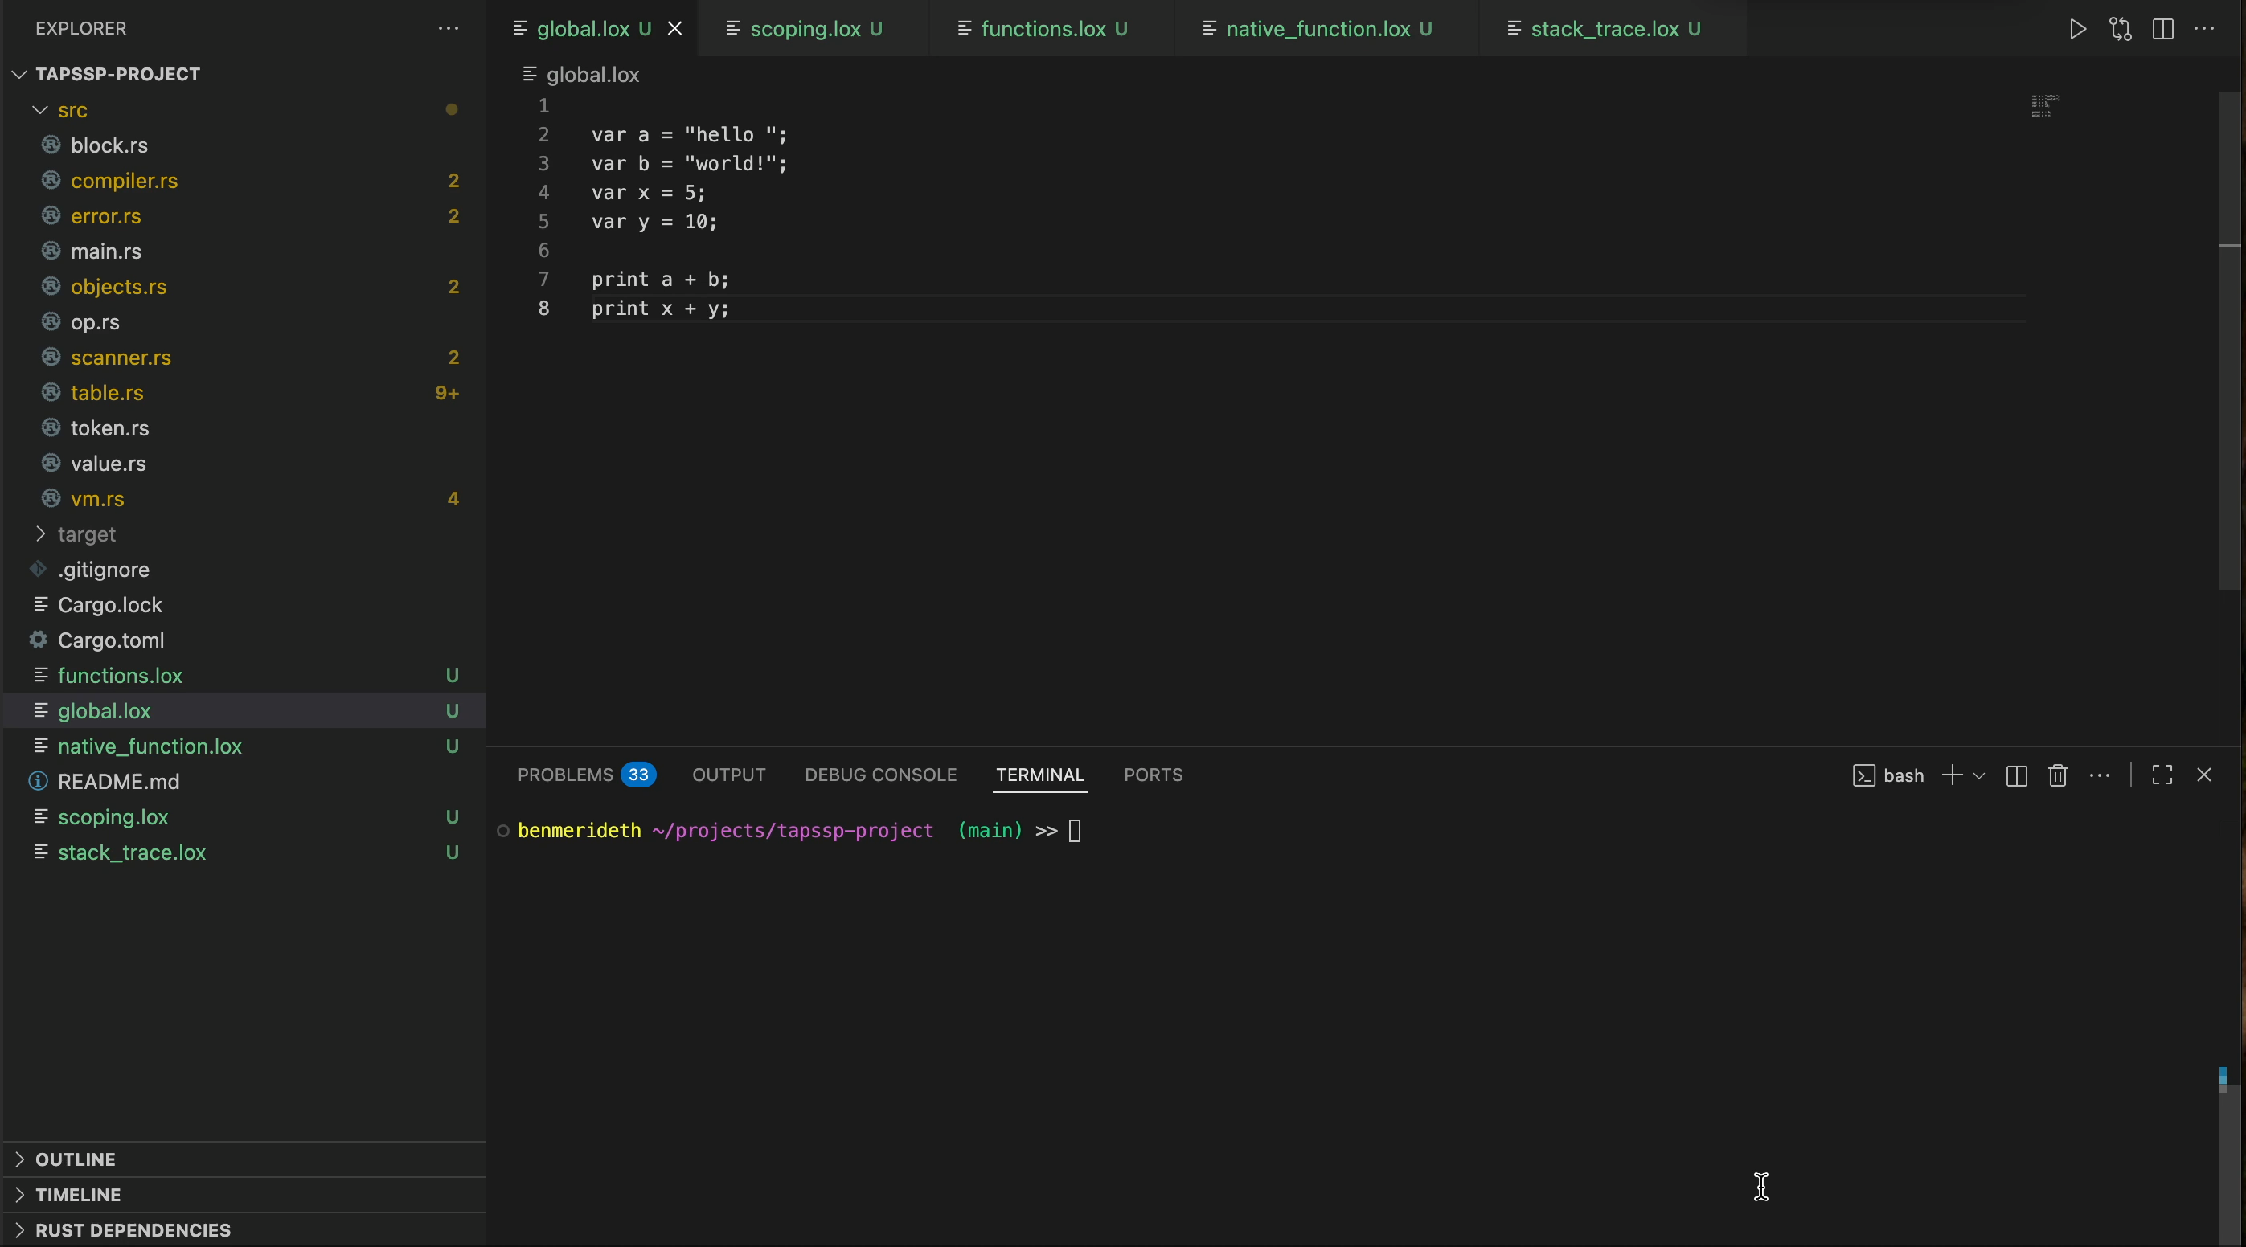
Notes:
Basic functionality in global scope. Defining variables and evaluating expressions.

Slide 2
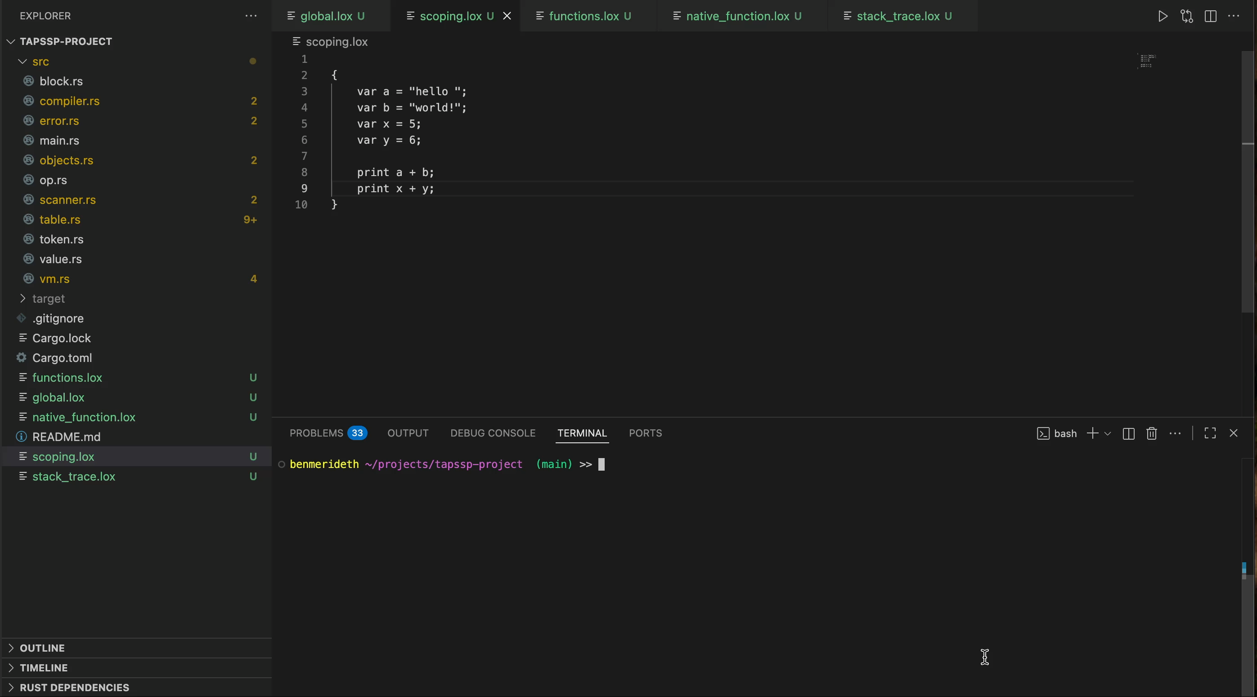
Notes:
Similar to globals example but this time using scoping to show that local variables are functional. The same logic used to implement this local functionality is used in handling function arguments.

Slide 3
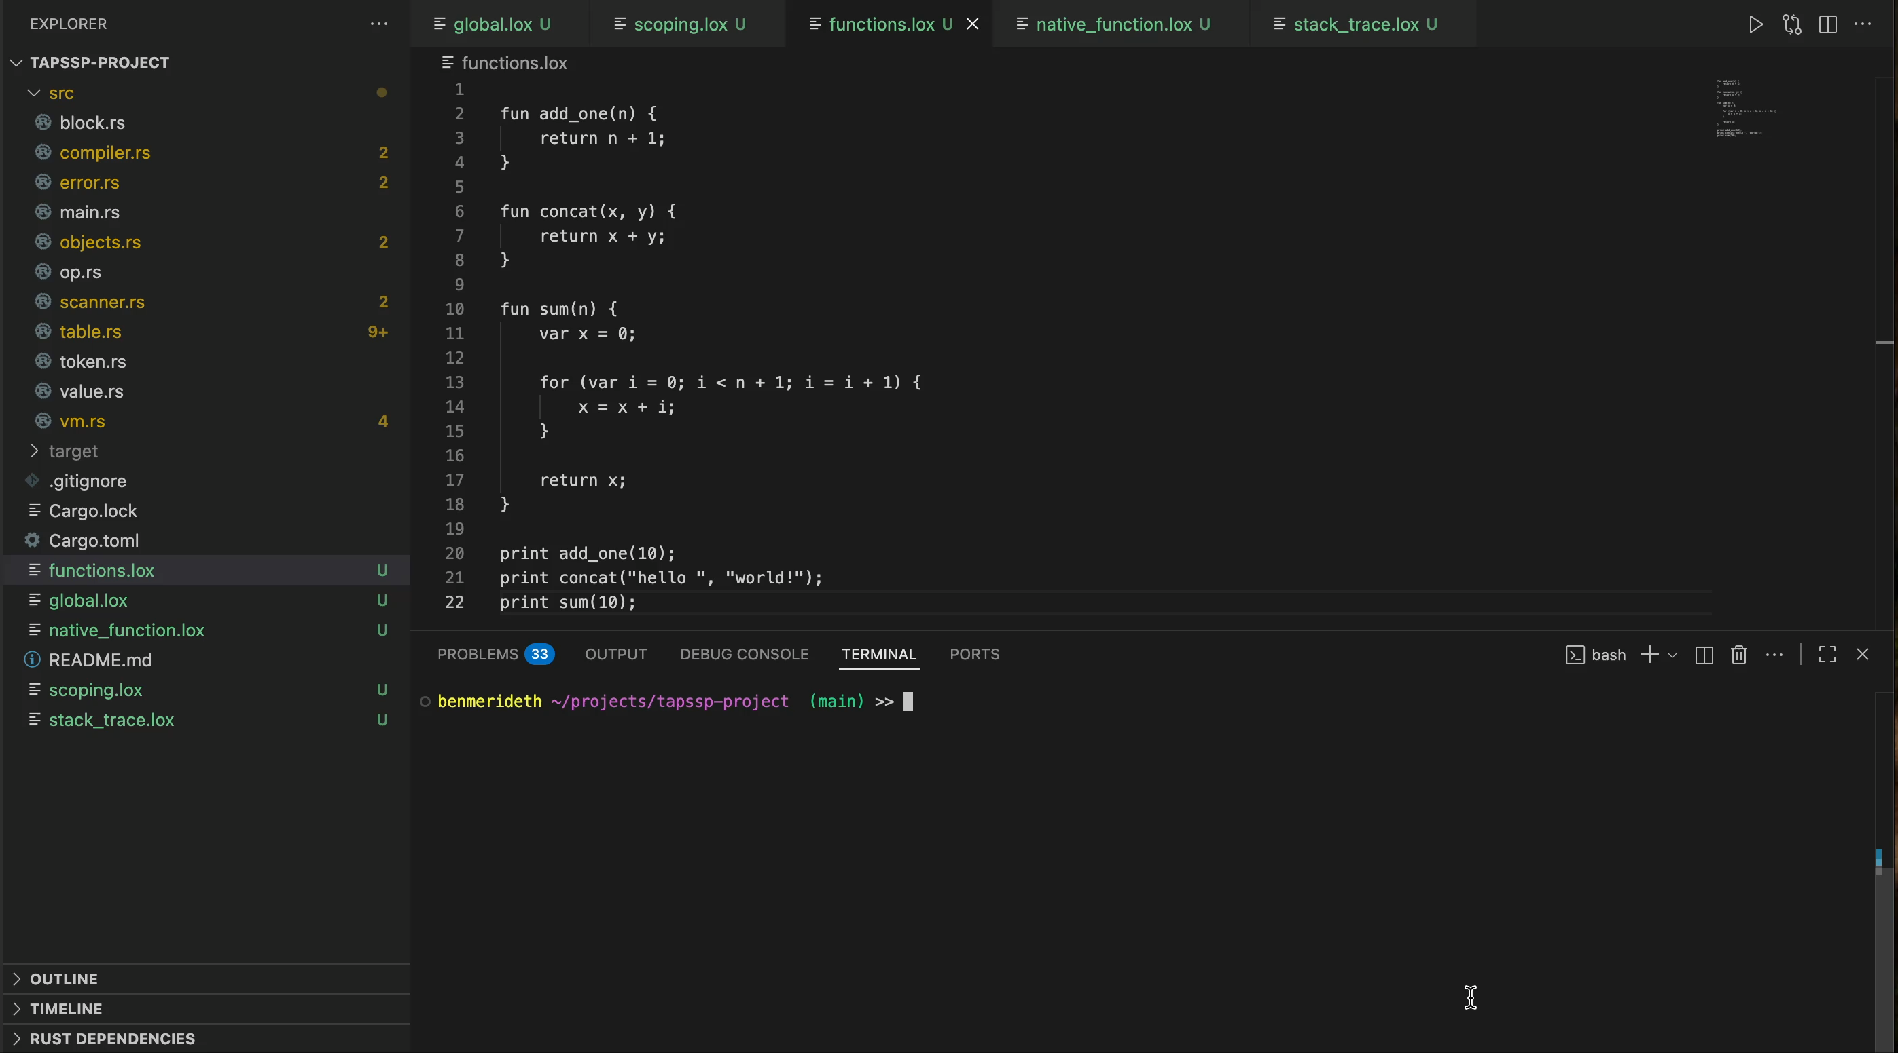
Notes:
Some basic function calls to demonstrate functions are working correctly.

Slide 4
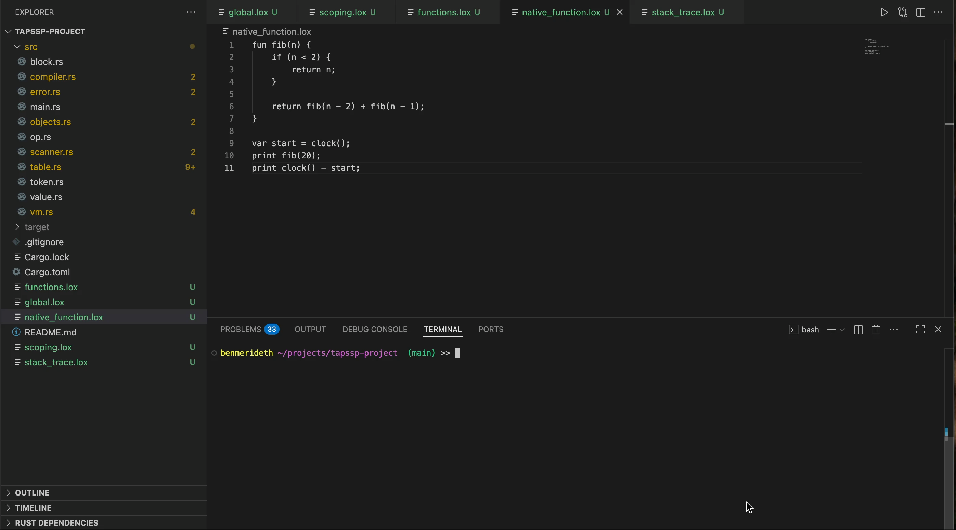
Notes:
Another function example but this time using both recursion and the only native function added so far (clock).

Slide 5
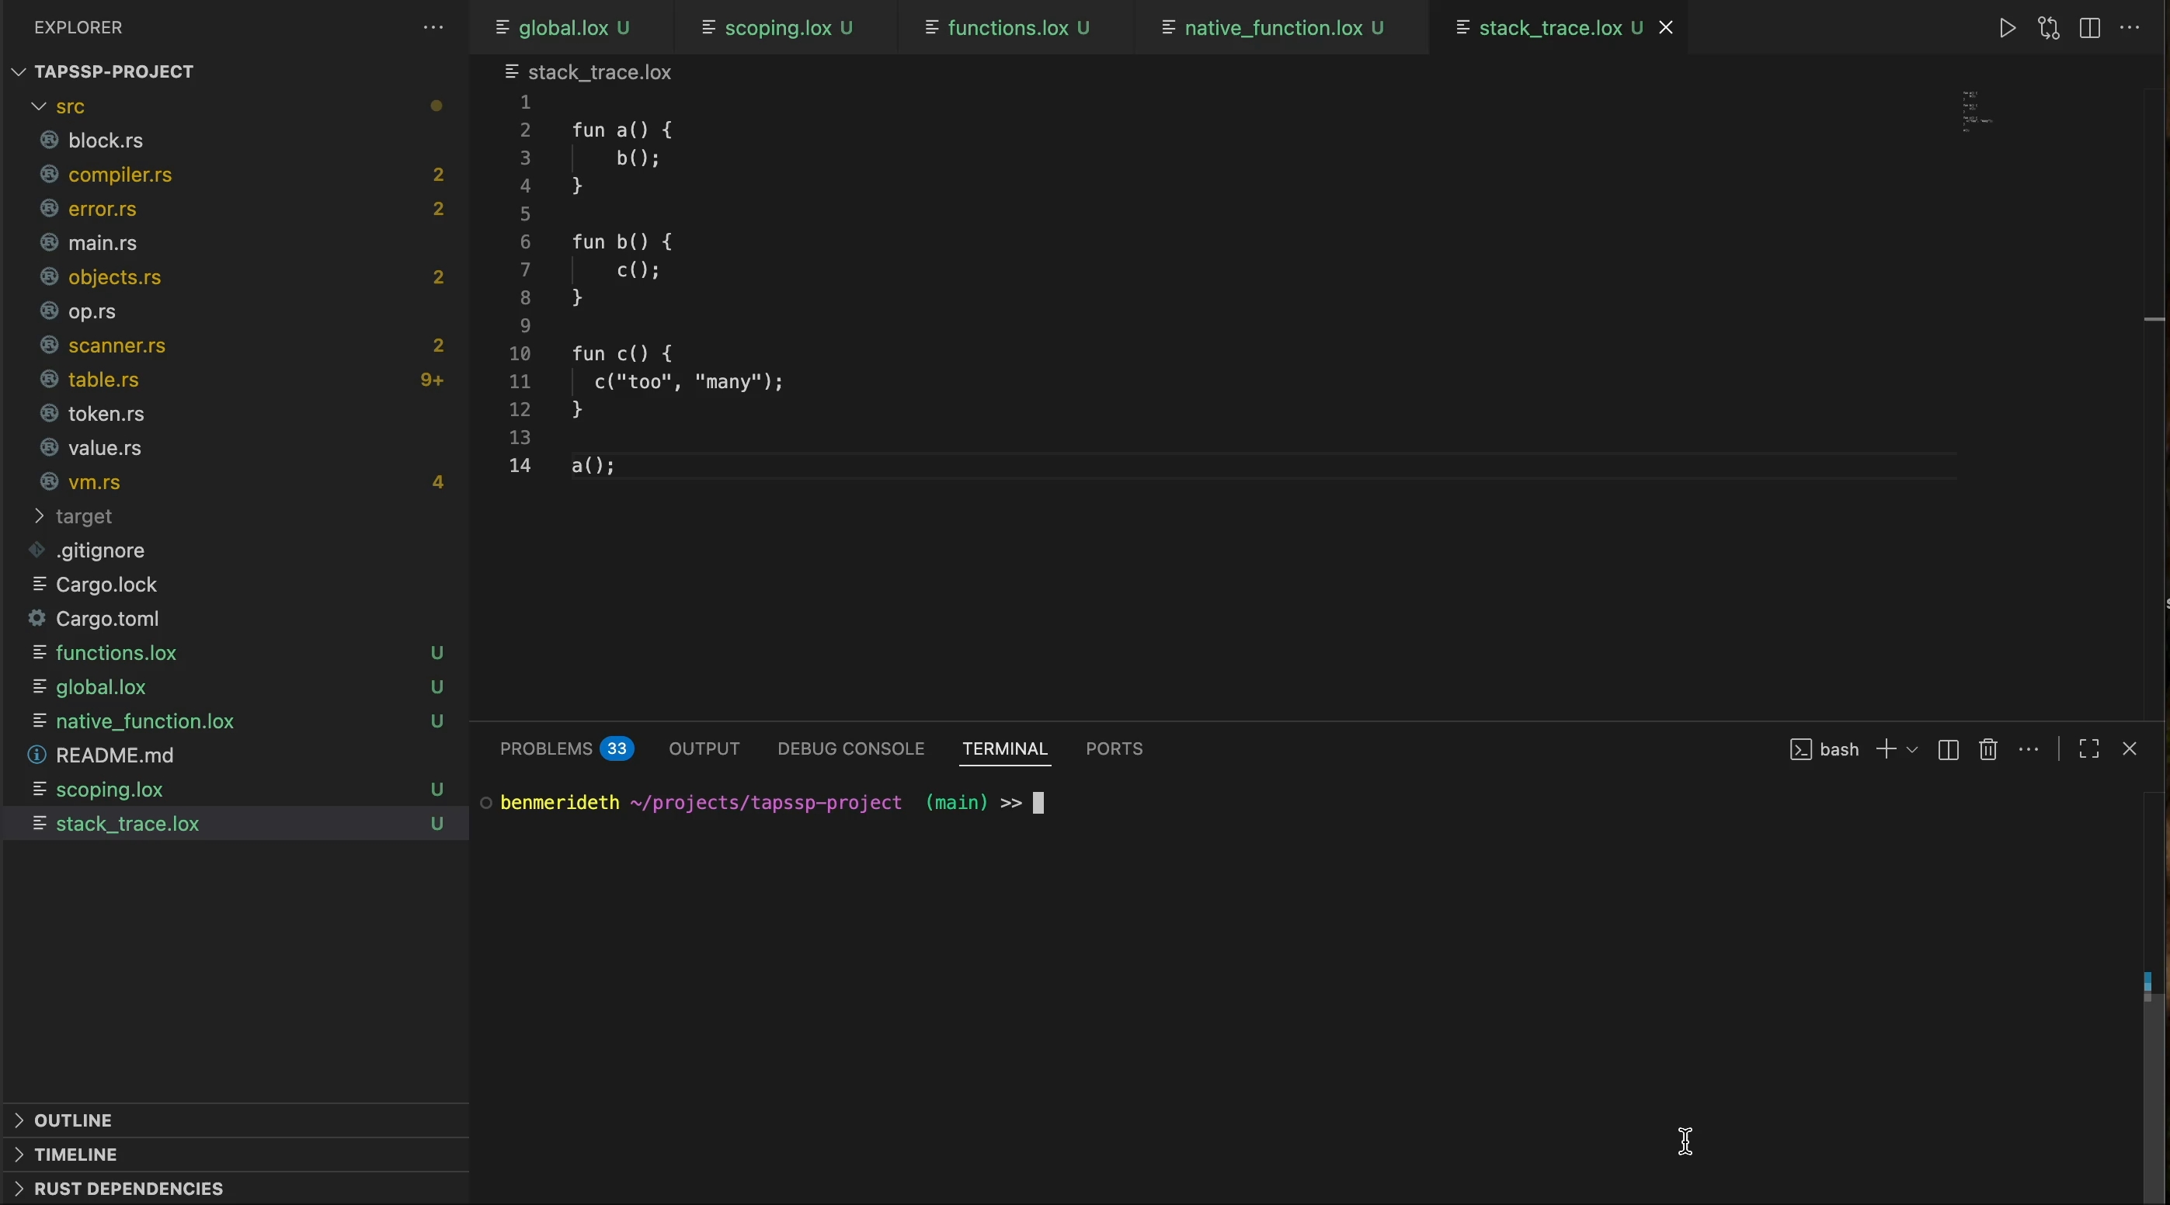
Notes:
Example to show the stack trace is working correctly

Slide 6
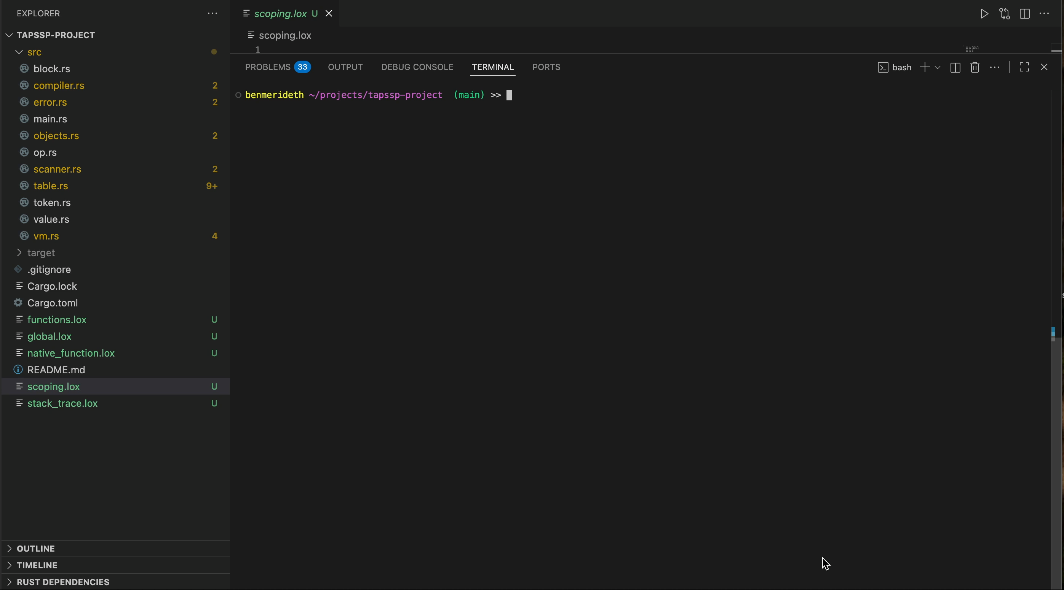
Notes:
This demo shows the disassemble functionality. The formatting is not great but it mostly works for now.
In the first two commands, you can see the instructions loading and then fetching the global variable x. You can see the constants section of the code (created by the compiler) being used to fetch the values. In the second two examples, you can see the add_one function being added to the table of global definitions. The disassembler neatly shows the contents of the function (name, block, arity etc). After that, you can see the function being fetched from the global table and then being called and executed using the stack of the virtual machine.

